Slide 1
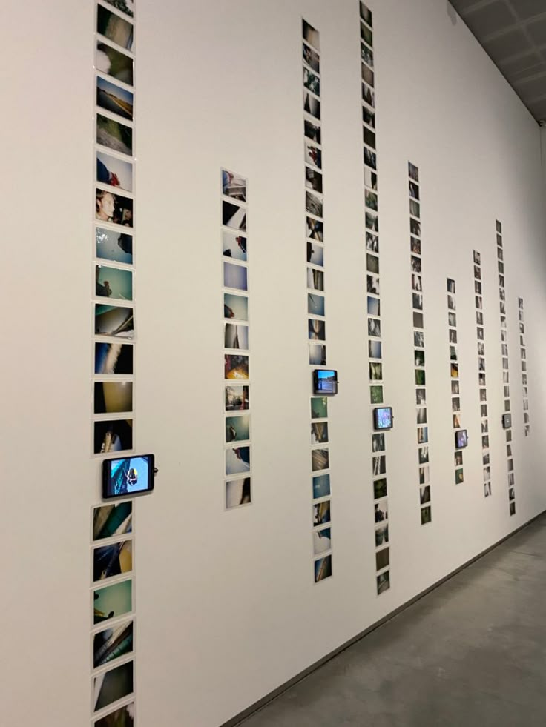


Digital Images as Immutable Mobiles
Grant Lattanzi, MA
Doctoral Student - Rutgers University New Brunswick, Department of Journalism and Media Studies
Society for the Social Study of Science 2025 Meeting
Communication and Digital, Social, and Personal Media
Notes:
Intro self - coming from comm and media studies
Two stories about seeing conjuring images
Sophia at Dinner
Grandma and grandpa trying to find prompts
The impetus for this project are practices like these, which I call conjuring media–
Practices which engage images ad hoc or as readily accessible material to convey meaning in everyday social interactions
How have particular ways of mobilizing digital images in social practices developed over time in relation to developments to personal devices? What practices engage the significant mobility of contemporary digital images? To what effects for visual culture?
The purpose of my talk is to think about how social practices engage mobility afforded to digital images through everyday devices (predicated on infrastructures).
I hope to think about the presence of these visual objects in time and space as they are increasingly engaged in everyday social life to convey meaning.
Through the interplay of iterations to consumer devices and social practice, the present moment is increasingly “open” to visual communication in new ways. It is this interplay, between technologies which materially uphold ways of interaction, and social practices, and the classic questions of technology and social change, which I hope to focus on today.

Slide 2
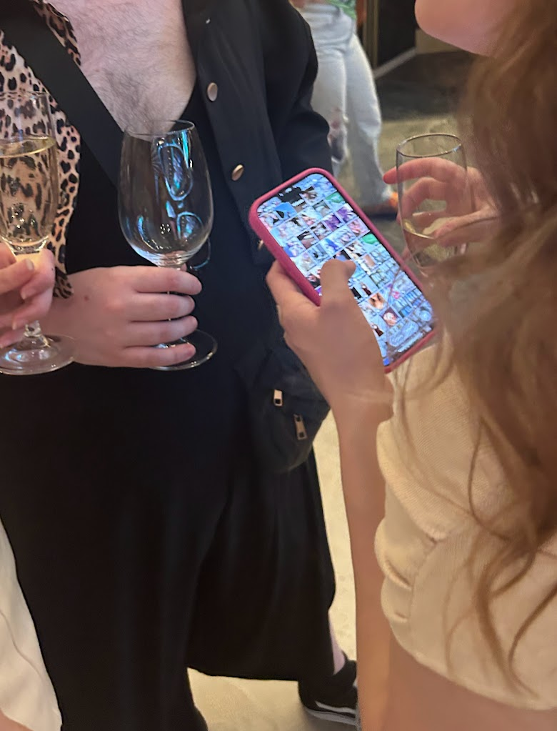
Starting point: Media Practices
Couldry, 2004
Ordinary things people actually do with digital images, from life and literature
“Conjuring”
Infinite Scrolling (Marek, 2023; Rixen et al., 2023)
Internet memes (Shifman, 2014; Donovan et al., 2022)
Notes:
People use devices to surface images in everyday social interactions.
What other social practices might we think of which engage digital images similarly? (As something continuously available across contexts, made mobile through particular technological channels)
I refer to the various uses of digital images, actions conducted by individuals as well as processes designed by technology producers, as media practices: actions, behaviors, rituals, or routines which are oriented towards media objects, forms, structures, and technologies in ways which situate media as consequential in “ordering” other social practices (Couldry 115).
Three particular media practices are worth describing in detail and will serve as examples for subsequent theoretical discussion:
– The first was conjuring
—infinite scrolling, relies on an organized, tagged, constantly changing stock of audiovisual materials on SMPs
—memes engage images from news broadcasts, video games, and renaissance art as sort of “ready made” visuals which are then disseminated through SMPs as NEW images. Not just making them but distributing them in many copies in particular ways
These examples demonstrate media practices predicated on plentiful access to massive collections of organized images, increasingly ‘within reach’ in routine social life.
In all these cases there is a sort of tact or taste exercised in collection or curation of digital images, as well as techniques and competencies to employ them.
Importantly there are normative conditions for these practices. We’ve all been shown too many baby pictures, or pictures which we’d rather not have seen. Or had someone try to show us a picture when we are focused on something else.
These are the practices I focus on in the paper but could just as easily been
Photodumps
Reaction pictures
Screenshots
I like to think about conjuring as a particularly illustrative practice to think about the mobility of digital images, as it shows how much visual material is “not here but could be” - and that is what got me thinking more materially about the technologies which afford this

Slide 3
Theoretical Approach
Science & Technology Studies
Distributed [communicative] agency (Suchman, 2017)
Consumption junction (Cowan, 1987)
Social Construction of Technology (SCOT) / Social History of Technology (SHOT)
Visual Culture
Social life of images (Awad, 2020, citing Bakhtin)
Visual culture & technology: W. Benjamin, Buck-Morss et al., (2024)
Platform seeing (MacKenzie and Munster, 2019)
Image-ness (Ranciere, 2008)
Theoretical frame
Immutable mobiles (Latour, 1986) Media Practices (Couldry, 2004)
Notes:
From practices I devised a sort of two fold theoretical approach – intended to shed light on social practices which are predicated on increasing mobility of digital images across contexts without ascribing a determinative role to either the artifacts or actors.
This is just a piece of the project so most of this isn’t relevant here, but I do want to draw attention to…Consumption junction is relevant to this talk…“the point at which the final consumers choose, employ, and experience a technology” (Fischer 17).
The metaphor of consumption junction forefronts that the dynamics of technological development in capitalist societies reify “producers,” who develop and produce technological artifacts, and “consumers” who use them after acquiring them in the marketplace. The junction is a reminder that the status of “end user” of a device or technological system is socially and historically contingent and that capitalist economic contexts continue to shape how and what technologies are developed.
Consumption junction also forefronts that, while devices are designed for particular uses, the ultimate ways in which people engage a device or system are instances of creativity, appropriation, and resistance, as well as more passive adoption.
The visual culture is less relevant to the rest of this talk, but i engage these thinkers to think about the mobility of the visual field more generally, and related sociocultural considerations.
Remaining with practices and technologies, I use Latour’s notion of immutable mobiles to understand the presence of digital visual materials in time and space.

Slide 4
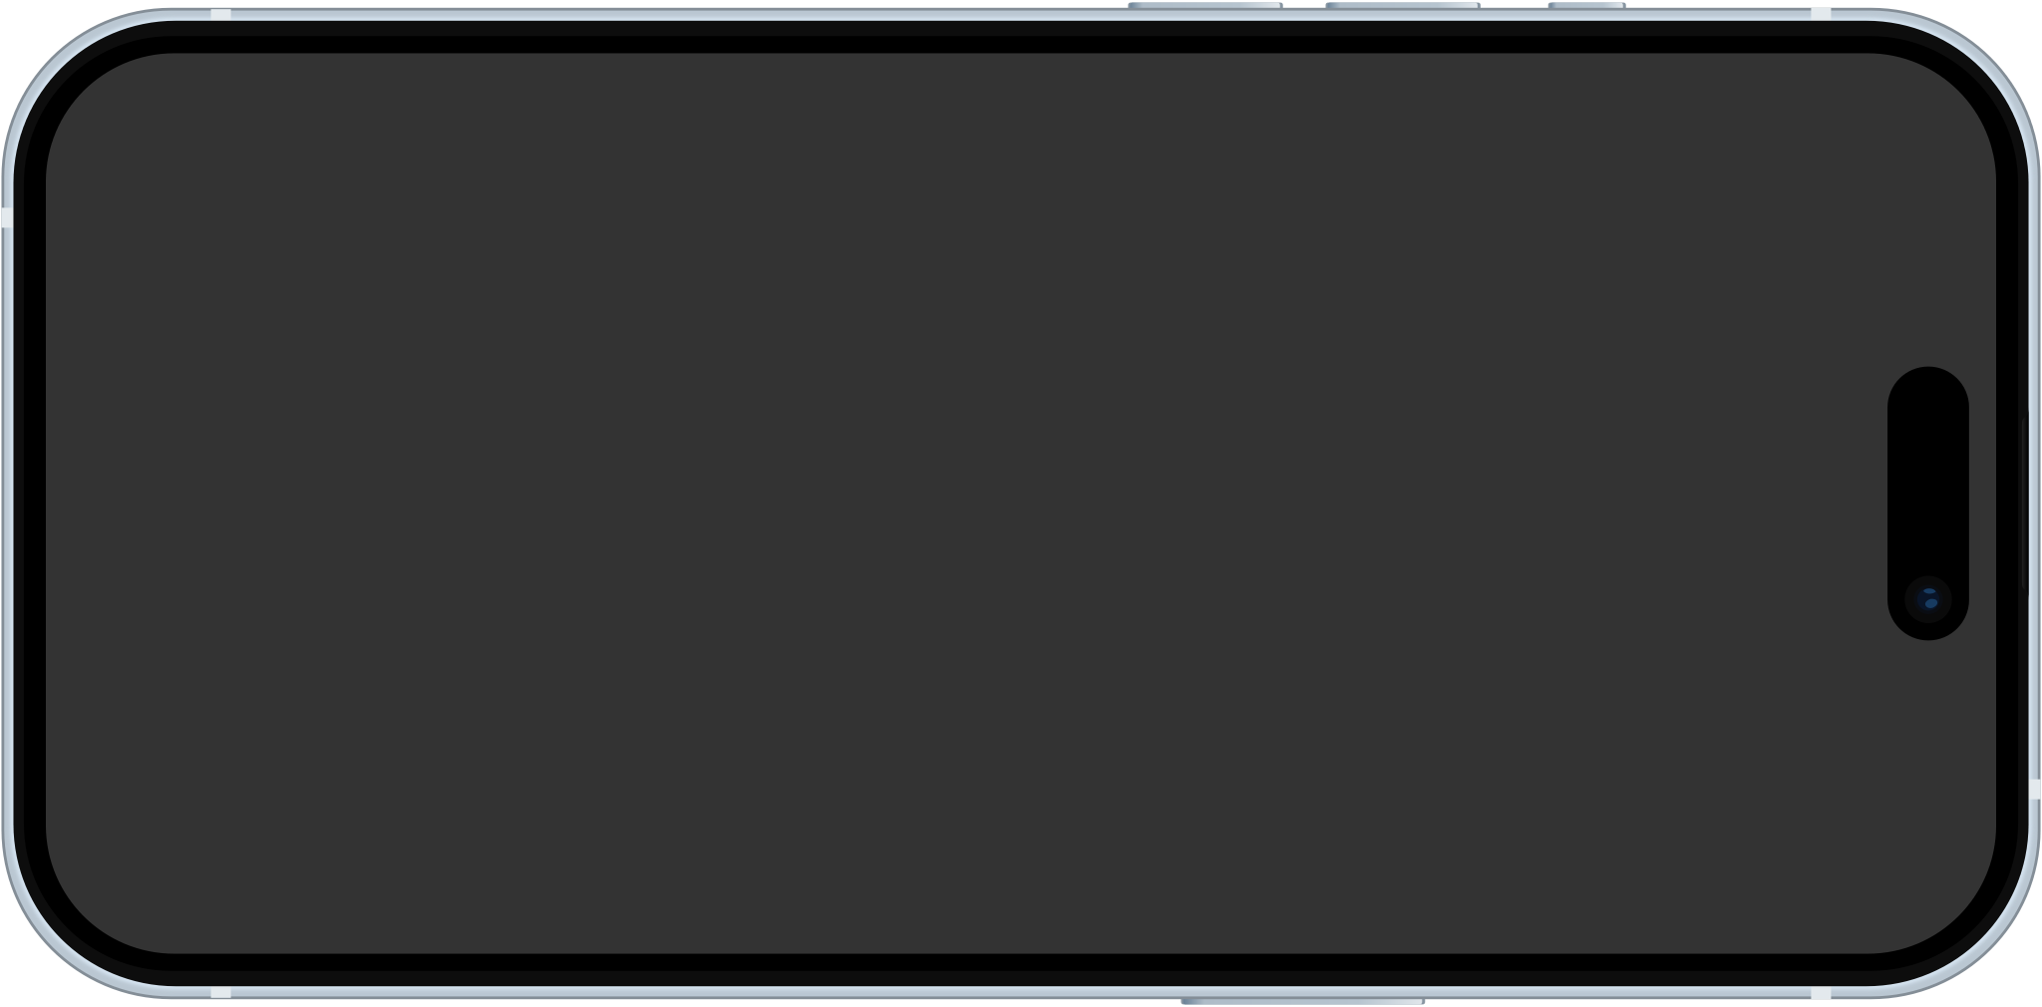
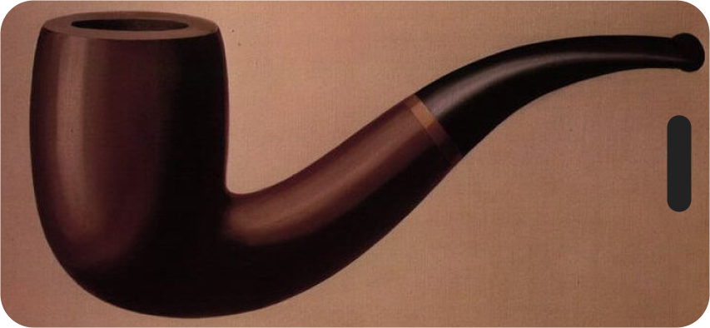

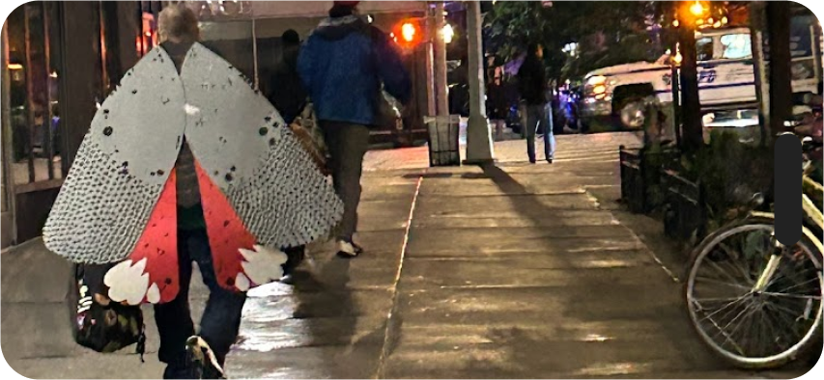
Digital images as immutable mobiles
Digital images afforded the status of ‘not here, but could be.’
Bruno Latour on Immutable Mobiles (1986)
Key claims
Changes to the technologies “around” digital images afford new mobilities to visual objects such that digital images are continuously accessible in time and space
The operationalization of the visual for platforms operationalizes visual material for social actors to use
Social practices engage this mobility of visual materials across contexts
Digital images as immutable mobiles, when? Where? For whom?
Notes:
Across all of these practices digital images seem to enjoy a new status, of ‘not here but could be.’
This status is contingent on time and space and social context, and my understanding is conditioned by practices covered in the literature but also observations from my everyday life in the united states.
Digital images are not immutable mobiles insofar as they are unchanging or fixed, and similarly mobile and accessible for all people in all places.
Indeed, thinking about when, where, and for whom digital images act as immutable mobiles we encounter many many times and places throughout the world where this status is not afforded to images. But as device makers feverishly pursue the next billion users, it stands to reason that this will be a status afforded to digital images for increasing numbers of people.
How Latour understood immutable mobiles
“immutable mobiles,” of “[media] objects which have the properties of being mobile, but also *immutable, presentable, readable,* and *combinable* with one another” (7, italics original).
Latour conceived of immutable mobiles in mid-20th century scientific laboratories within a process of “going there” – as in spatially navigating elsewhere – and “com[ing] back” with “things… able to withstand the return trip” (7). the enterprising researcher must collect, combine, transport, and present charts, graphs, or other “mobile” objects, each step of the way making decisions about how to convey information.
What is important is this initial vision of immutable mobiles rests on the expertise of the scientist, who constructs visualizations in accordance with both aesthetic and scientific conventions using particular technological means available to them (Burri & Dumit 303).
How digital images in everyday life differ.
In contrast, everyday digital images acting as immutable mobiles is predicated on one’s savviness as a *user*, that is, one’s competency navigating and manipulating various devices and interfaces effectively, often without disrupting the cadence of an interaction.
When a *specific* image is desired the interlocutor can engage their own technical ability to “go there” to a digital image, wherever it resides on an SMP, personal collection, or even an IM channel, and “come back” without breaking the flow of an interaction.
In place of scientific convention, we have normative uses of personal devices and images in communication
Smartphones in hand, contemporary interlocutors gain a similar ability to gather inscriptions–personal photographs, screenshots, memes, historical images, clips from film/television, maps, graphs, illustrations, artworks–and mobilize them in everyday interactions. These diverse cultural texts unified in the form of the digital image achieve the status of immutable mobiles, readily surfaceable on mobile screens, given contemporary arrangements of technologies and social practices and norms
Key claims:
Instantiated by changes to technology “around” digital images, conditioned social practices engage digital images
In operationalizing images for digital platforms, (Platform seeing), the new mobilities of the visual are being engaged in social practice.
The way digital images have been made immutable mobiles depends on all of us being very good customers, paying phone bills, and keeping our devices up to date with the latest.
There is a lot more to unpack in terms of visual culture particularly in relation to the political economy of digital images, but I want to actually spend the rest of my time on an example of how images are made more organized, more readily accessible in the state of “not here but could be” through iterations to Apple’s i-Operating System smartphone interface.

Slide 5
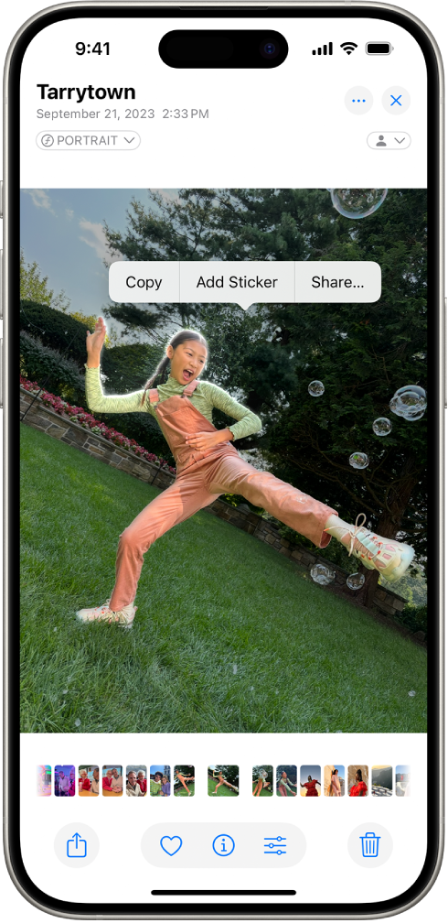
Apple’s ‘Messages’ from 2015-2025: a case study
Interfaces encode assumptions (Manovich 2013)
Interfaces like IMs are key points of interaction between lifeworlds (Drucker 2011)
Interfaces link individuals with larger systems (Willim 2024)
‘Messages’ centralizes technologies instantiating digital images as immutable mobiles
Smartphones
Computer vision (Dobson 2023)
Digital Images
Others
https://support.apple.com/en-am/guide/iphone/iph9b4106303/18.0/ios/18.0
Notes:
This is an example of how digital images have been made immutable mobiles through software iterations and social practices according to the dynamics of consumption junction
Why study interfaces in general?
Entrances into larger issues
IMs connect people to people
At consumption junction, they encode assumptions about users
They link users to larger systems (infrastructures)
Why study THIS interface
In addition to being popular, Apple has this ritualistic process of demonstrating their software through events and visuals, which i used as data.
Ive used messages for over a decade so have my personal orientation and understanding of this interface which conditions my analysis
Within messages we see the technologies being interated and networked to increase the mobility of digital images.
Central to these media practices. All are intentionally broad, non technical definitions. All are influencing the means by which digital images are “held” within arms reach. Others include Social Media Platforms and, “The Cloud” (offloading system memory but maintaining access), and of course, personal computers and tablets.
DF smartphone - could do laptops, tablets, etc., but the smartphone, in its mobility and increasing centrality to infrastructures of transportation and commerce, acts as mobile terminus for writing and imaging– that is, for inscription, as a container which allows users to “Carry” digital images as immutable mobiles, to retrieve them and make them visible across contexts
DF computer vision
Taking cues from James Dobson computer vision to refer to the mechanisms which transform digital images into computer interpretable information, and the operations predicated on this transformation
DF digital image
broad notion of digital images as visual materials engaged through technologies predicated on digital computation. This includes still images as well as video, and captures all predominant visual file formats including JPEG, HEIC, PNG, GIF, PDF, and more.

Slide 6
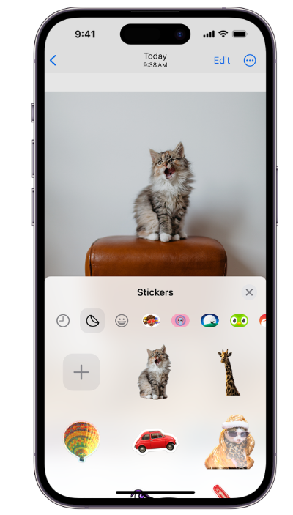
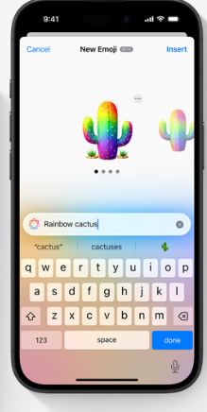
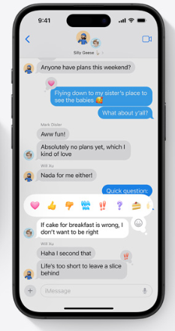
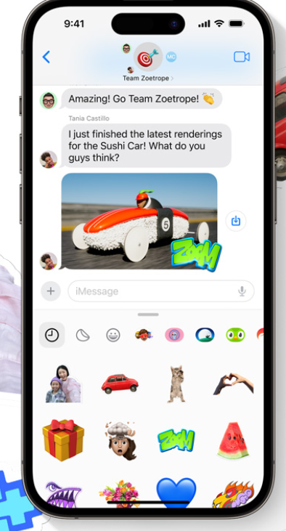

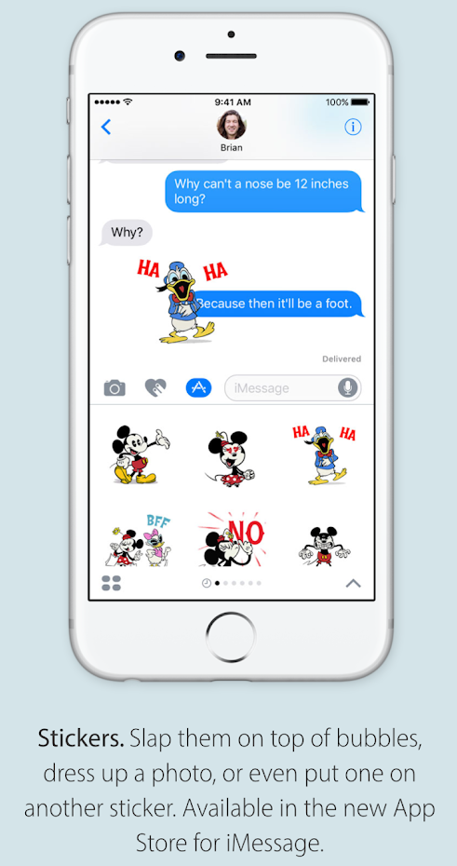
Tap back to Stickers
iOS 10, 2016
iOS 17, 2023
iOS 18, 2024
"Delightful images created just for you." – iOS 18 promotional material
"Express yourself in bold new ways in Messages.” - iOS 10 preview
Notes:
Tap back, stickers, and emoji all merge to form flexible uses of visual contents.
From tap back and emoji to an intermodal interface through and through.
Along the way, we can exchange text for emoji (instead of scrolling through categorically sorted emoji)
We can MAKE stickers
We can always COPY/PASTE from google.
But where we can paste, how, and with what edits how quickly, is new
Tap back, stickers, emoji are all interchangeable, and incorporated into the “keyboard”
Ending with AI is telling. With gen AI, which is predicated on comp viz techniques, we create visuals ad hoc, not just engage them as readymade.

Slide 7
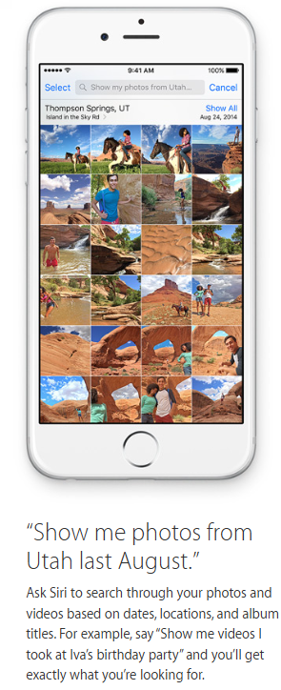
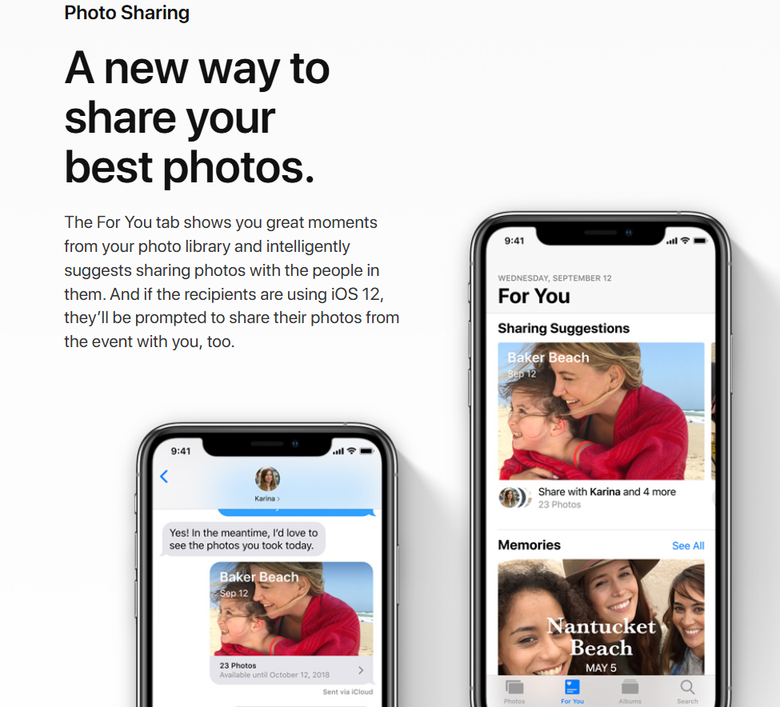
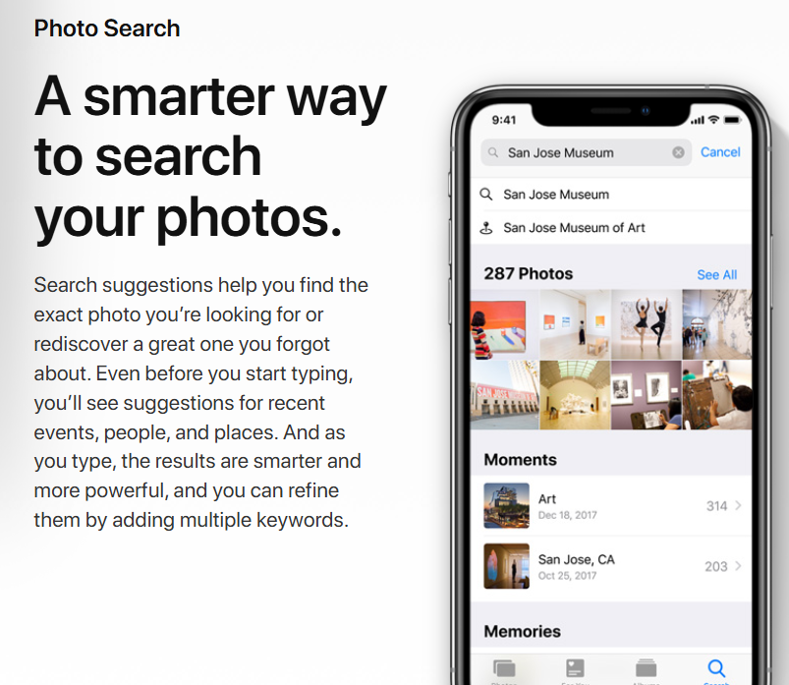
Navigating & Building Digital Image Collections
iOS 12
iOS 9, 2015
Notes:
Outside messages, we see how images are increasingly organized, collected, and exchanged automatically.
At first, this is based on metadata. Location the image was taken.
Then facial recognition (just a year or two after they switched from fingerprint to facial recognition features in hardware)
Then object recognition

Slide 8

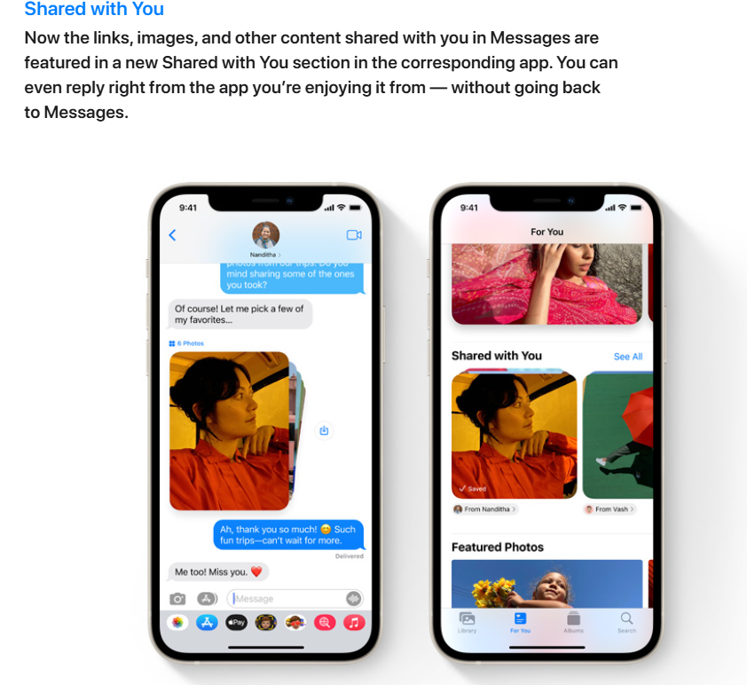
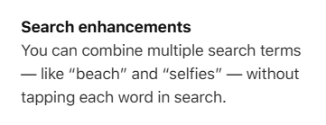
Navigating & Building Digital Image Collections
iOS 15
iOS 17
Notes:
Now based on computer vision and automated process more generally computer vision applies to reducing the distance there and back predicated on digital images fluid relationship to text and data. What is called “the captioning task” or ascribing text descriptions to visual images is automated.

Slide 9
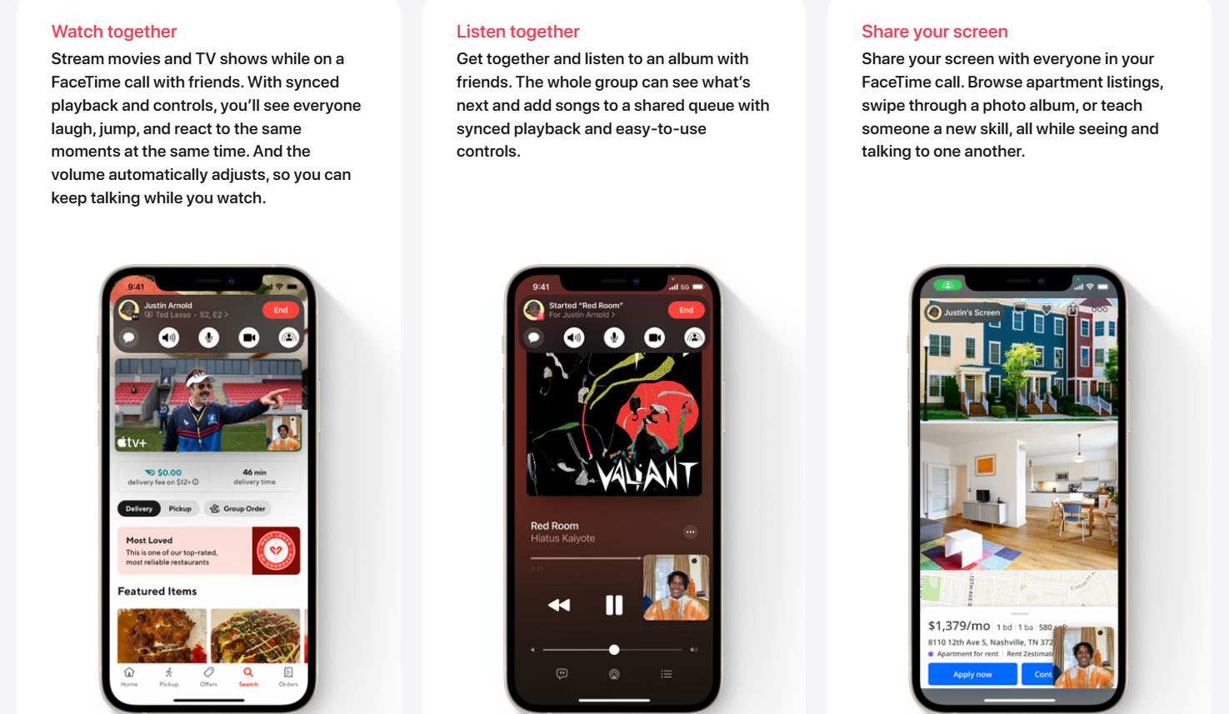
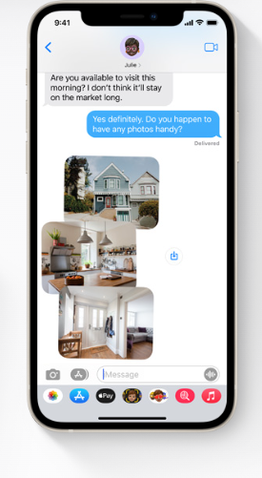
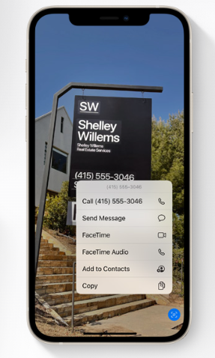
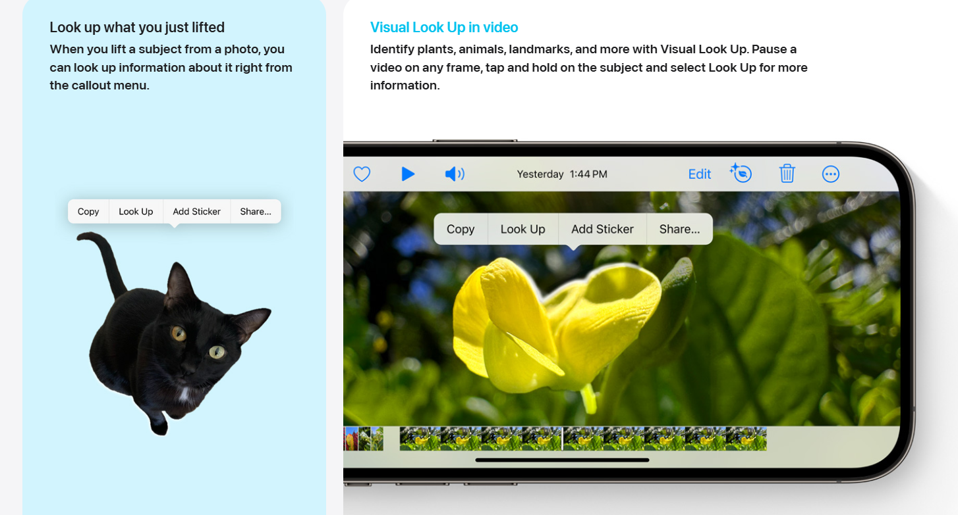
Other Uses of mobile visual material
iOS 17
iOS 15
Notes:
Digital images have been “opened” to platforms in new ways, thus enabling the design of additional features which are currently being modelled to users.
All images within computer vision are subject to the existence of other images,” (Dobson 58)

Slide 10
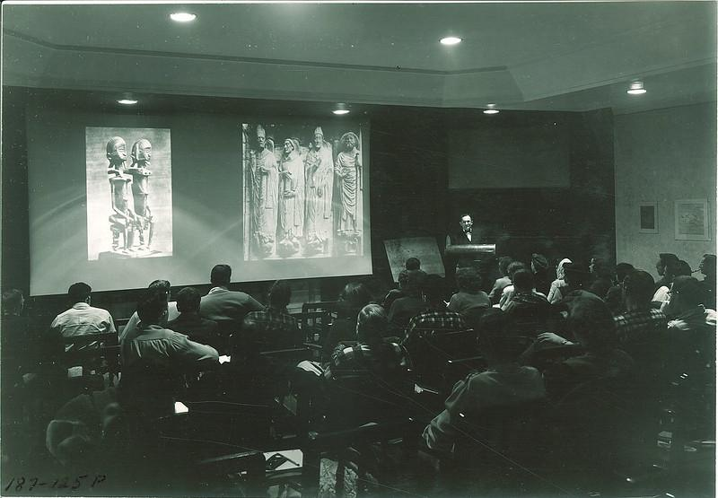
Trajectory
‘Messages’ over time afford more visual elements to IMing, making the journey ‘there and back’ seamless
Increasing use of text to ‘search’ for/through visual material and automated organization of image collections (CV applications) --Fluid relationship between image, data, and text
In practice, we see “the tighter integration of images, techniques, and devices that organize visual culture in the present” (Dobson, 2023, p. 50, italics mine)
Ranciere’s ‘image-ness’: “new regime of relations… between the sayable and the visible” (2008, p. 6)
Art history lecture using a slide projection of images, The University of Iowa, 1960s
Creator: Kent, Frederick W. (Frederick Wallace), 1894-1984
Notes:
The overall trajectory of messages is to make images more mobile, to reduce friction at every point. Familiar appeals to seamlessness
We see how computer vision is being put to use to ease the process of organizing, combining, and retrieving images, reducing the distance there and back predicated on digital images fluid relationship to text and data.
What i mean by that is that what is called “the captioning task” or ascribing text descriptions to visual images, has been automated such that text, image, and data are all mutually invokated in the organization of the visual field.
Platform vision lets us think about these minute changes as the organization and making available of visual material in time and space. Quote.
When an image’s absence is felt, say during a face to face conversation, and then is made present to convey meaning in that interaction, we see what Ranciere called imageness.
If “images are used to think” (Buck-Morss et al. 124), that is, if they are one of many symbolic vehicles which act as “things thought with” (Carey 49), then images in our digital age are characterized by an ongoing oscillation between the mental (remembered) and material (rendered). Digital images have become means of expression, afforded by contemporary networks of media and communication technologies.
It is helpful to think about the techniques which would have gone into this 1960s art history lecturers collection and display of visual material vis a vis today. Our devices leave the option for a visual aid, a literal image to give you a picture of what is on my mind.
In the paper, I follow this path further, engaging Walter Benjamin to think about the temporality of the visual field. But for today, I’ll conclude by returning to consumption junction

Slide 11
Return to Consumption Junction
“People turn new devices to various purposes, even ones that the producers could hardly have foreseen or desired. As much as people adapt their lives to the changed circumstances created by a new technology, they also adapt that technology to their lives. The telephone did not radically alter American ways of life; rather, Americans used it to more vigorously pursue their characteristic ways of life.” (Fischer, 1992, p. 5)
Images must flow… except for IP…
Distributing communicative agency through artifacts which surveil and which are iterated without formal input from users
Not a causal relation between technological changes and social practice
Moving digital images are economically generative.
Notes:
The overall trajectory of messages is to make images more mobile, more combinable (in terms of remix and collection), and more visible. Friction for the flows of visual content is reduced at every point. Except one – go into hulu example.
Here we are reminded how economic structures such as IP condition technical development. USER images must flow… Producer images are granted a different status.
Ive engaged STS in this project because im in the tricky territory of the relationship between technology and social change. You can lead a horse to water but you can’t make them drink. It is social practices, normative orientations to and uses of personal devices in everyday communication, which condition this.
I think we need to think through more robustly the dynamics between producers and consumers of technology given the near ubiquity of monitoring device use, and the mediating role of norms and conventions in this. The consequences, in terms of everyday social life, are not determined intentionally by either groups at the junction. Claude Fischer quote.
While users certainly use devices agentically, they are not devices most users can control or understand. Literal and metaphorical black boxes.
As computer vision opens new possibilities to surveil users through collections of images, and the possibility to CONTROL flows of images with new precision, the concentrated power to produce devices and platforms through everyday social life is accomplished, is troublesome.
Digital image mobility is economically generative:
SMPs profit from infinite scrolling
Apple of course would automate making photo collections because they SELL PHOTO STORAGE
Those who profit from charging for access to mobile data networks stand to sell more data when images are exchanged (than text)
The mobility of digital images is predicated on their enclosure in systems which for select few companies to profit off of their exchange. Should the integration of images continue this integration with social life, this will become increasingly untenable.
It is oft repeated, particularly by our colleagues doing important decolonial work, that controlling a populace is controlling mobility of bodies, goods, and ideas. Is a here and now constantly populated with images of not-here, and not-now, desirable? For whom?
Can this movement of digital images be made socially, communally, or economically generative for everyday people? How? For whom? Under what conditions?

Slide 12
References
Awad, S. H. (2020). The social life of images. Visual Studies, 35(1), 28–39. https://doi.org/10.1080/1472586X.2020.1726206
Buck-Morss, S., Michaels, A., McCaughey, K. (2024). Seeing Making: Room for Thought. Inventory Press.
Couldry, N. (2004). Theorising media as practice. Social Semiotics, 14(2), 115–132. https://doi.org/10.1080/1035033042000238295
Cowan, R. S., (1987). The consumption junction: A proposal for research strategies in the sociology of technology. In (Bijker, W. E., Hughes, T. P., & Pinch, T. eds) The social construction of technological systems: New directions in the sociology and history of technology, 253-72.
Carey, J.W. (1989). Communication as Culture: Essays on Media and Society. Boston, Unwin Hyman.
Dobson, J. E. (2023). The Birth of Computer Vision. U of Minnesota Press.
Donovan, J., Dreyfuss, E., & Friedberg, B. (2022). Meme Wars: The Untold Story of the Online Battles Upending Democracy in America. Bloomsbury Publishing USA.
Drucker, J. (2011). Humanities Approaches to Interface Theory. Culture Machine, 12, 1–20.
Fischer, C. S. (1992). America calling a social history of the telephone to 1940 (Reprint 2020). University of California Press. https://doi.org/10.1525/9780520915008
Latour, B. (1986). Visualization and cognition: Thinking with eyes and hands. Knowledge and society: Studies in the sociology of culture past and present, 6(1), 1-40.
Manovich, L. (2013). Software Takes Command. Bloomsbury Academic.
MacKenzie, A., & Munster, A. (2019). Platform Seeing: Image Ensembles and Their Invisualities. Theory, Culture & Society, 36(5), 3–22. https://doi.org/10.1177/0263276419847508
Marek, J. (2023). The impatient gaze: On the phenomenon of scrolling in the age of boredom. Semiotica, 2023(254), 107–135.
Ranciere, J. (2008). The Future of the Image. Verso Books.
Rixen, J. O., Meinhardt, L.-M., Glöckler, M., Ziegenbein, M.-L., Schlothauer, A., Colley, M., Rukzio, E., & Gugenheimer, J. (2023). The Loop and Reasons to Break It: Investigating Infinite Scrolling Behaviour in Social Media Applications and Reasons to Stop. Proc. ACM Hum.-Comput. Interact., 7(MHCI), 228:1-228:22.
Shifman, L. (2014). Memes in Digital Culture. MIT Press.
Suchman, L. (2017). Agencies in Technology Design: Feminist Reconfigurations*. In Machine Ethics and Robot Ethics. Routledge.
Willim, R. (2024). Mundania: How and Where Technologies Are Made Ordinary. Policy Press.

Slide 13
Considerations for Visual Culture
Increasing mobility of the visual
Social life of images marked by oscillation between mental and material.
Now-time & The Temporality of Visual Culture
Images as “things thought with”
With what technologies, techniques, and to what imagined ends, consciously or unconsciously, do users maintain digital images as immutable mobiles?
Notes:
Images as symbolic stock:
Contemporary interlocutors are using audiovisual images to share their experiences–their subjectivity, their maps of meaning–with others, mobilizing media objects in everyday encounters in new ways. Audiovisual images as symbolic stock are akin to language;
a status which is afforded to images by a truly global arrangement of technologies which renders an incomprehensibly large stock of images as searchable, linked, and readily producible and reproducible.
Mental and material
audiovisual images as technologically afforded symbolic stock oscillate between the mental and material, decoded in the mind of an interlocutor, encoded and decoded again when surfaced on a little black screen, and off into the mind and maps of meaning of another interlocutor, where the circuit continues.
I am giving you a [mental] picture of something either with words or visual representaiton
Historical analogues:
There are many conceivable historical antecedents or analogies for the conjuring maneuver such as pulling a book from a shelf and pointing to its contents, searching for an image on a search engine and displaying it to an interlocutor in an office space, or displaying a painting on a projector slide in an art history class. SCOT’s emphasis on affordances and consumer devices reminds us that only recently have we entered a technological arrangement whereby mobile phones are technically capable of bringing innumerable audiovisual representations within arms reach, just beneath the surface of the smartphone screen, ready to manifest.
Future research
Research on the conjuring maneuver should thus focus on this newly afforded and negotiated function of audiovisual images. What things do people accomplish when they conjure? It should also prioritize the use of devices in micro-contexts, while enabling us to look through these instances to speak to macro-level changes to everyday social structure, raising theoretical concerns for cultural development and analysis.
But something is missing… the political economy of these social uses of digital images. Digital images in the channels they are conjured from, are doing other things for data-extraction based models of capitalism

